Slide 1



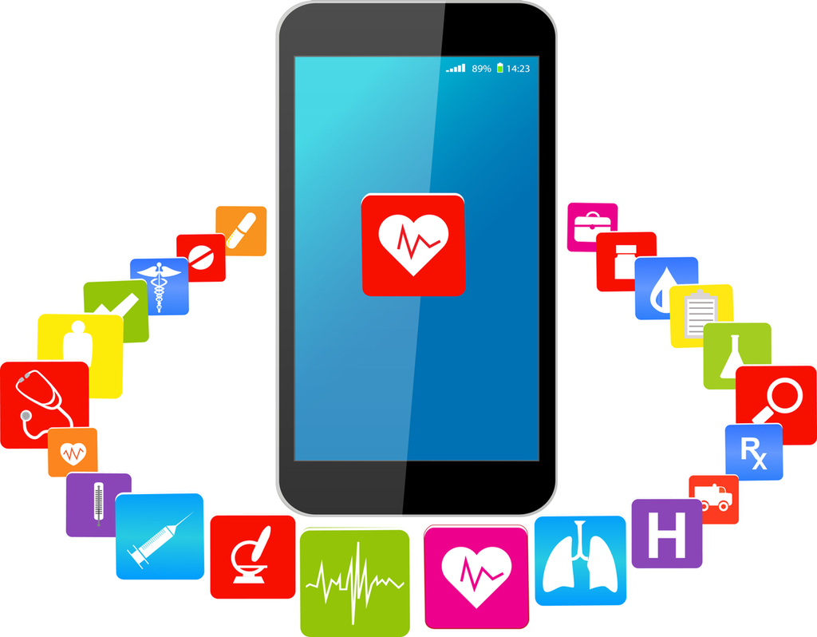
Coders: IJEOMA IKEDUM and EVBUSOGIE SOGBESAN LINK TO CODE :
https://github.com/ksu-hmi/Tele-health-App
TELE-HEALTH APP
REVOLUTIONIZING PATIENT HEALTHCARE...your health medical diAgnosis and symptoms tracker right at your fingertips

